Slide 1
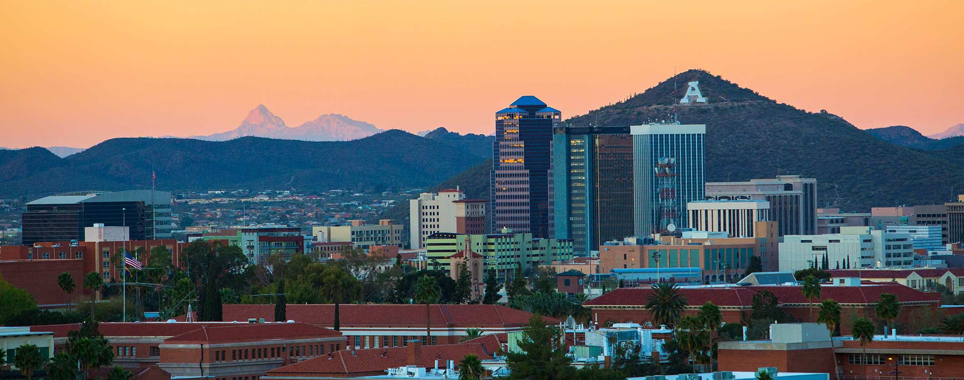

Slide 2
Course Introduction: Law 640P
Community Engagement and Sustainable Development of Mineral Resources

Slide 3

Thanks to

Slide 4
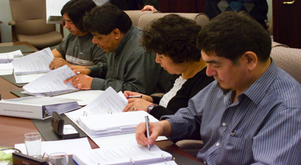
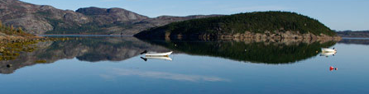
Sustainable Development
“Sustainable development” is an evolving concept that spans a range of interconnected social, environmental, and economic considerations. Modern mining companies no longer focus only on the economic value of a given resource but also carefully assess and manage social and environmental impacts of mining activities.

Slide 5
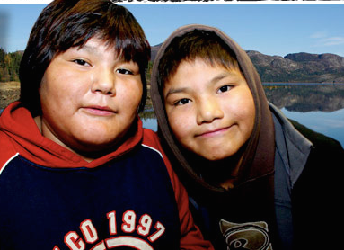
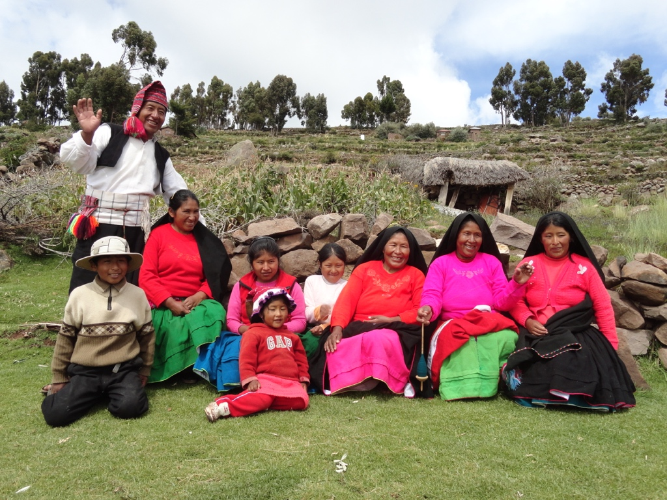
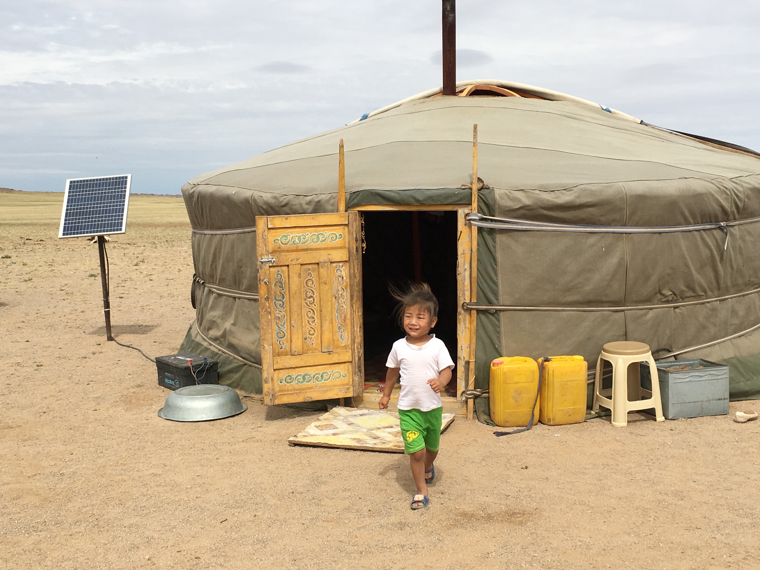
Community Engagement
Understanding the impacts and benefits of mineral development how a mining project can help advance local development objectives requires early and ongoing engagement with communities—to share information and also to be informed by the experiences of local community members. Responsible mine management involves development and maintenance of relationships that protect and respect the rights of local communities.

Slide 6
Law 640P
Course Description
This course looks at the evolution of the concept of sustainable development and its integration into laws, policies, and practices for the mining sector. The course then focuses on the rights and expectations of communities, including the rights of Indigenous communities, related to the mining sector.

Slide 7
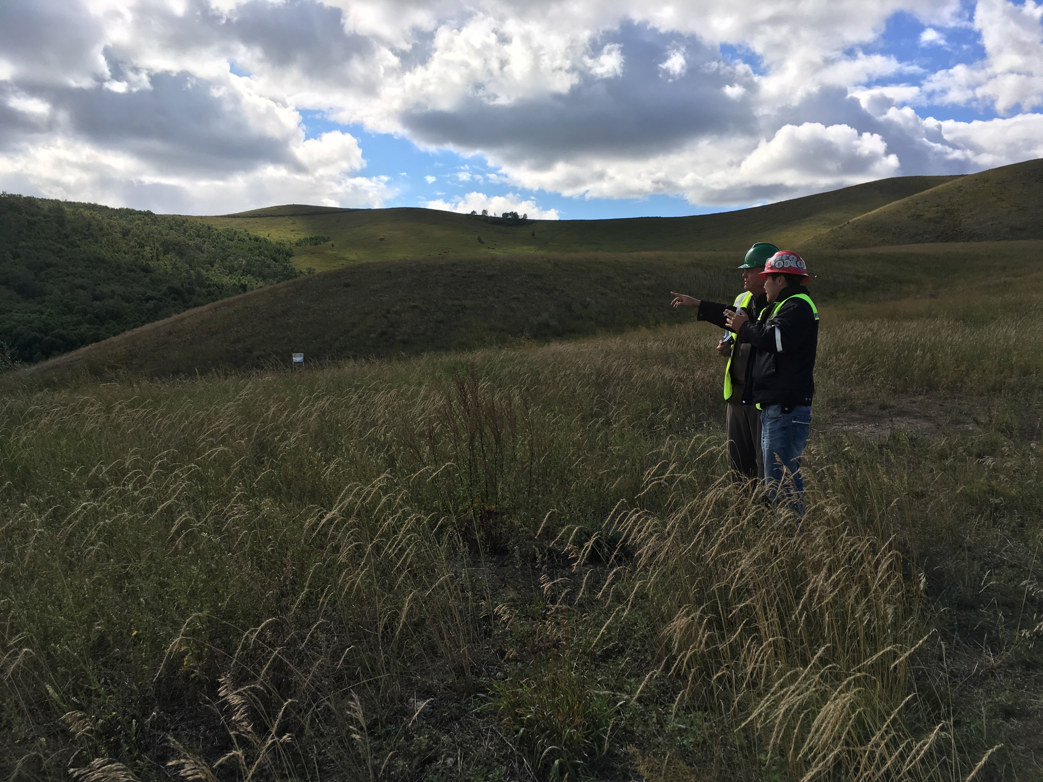
Who Should Take This Course?
Lawyers, engineers, policymakers, and other professionals who aim to work with mining companies, host governments, local communities on or near mineral deposits, or civil society organizations will benefit from understanding law and policy frameworks and good practice around community rights, indigenous rights, and avenues to protect these rights and related expectations.

Slide 8
Your Professors
Kristi Disney Bruckner, JD, LLM
Ashley Smith-Robert, JD, LLM
Luke Danielson, JD

Slide 9
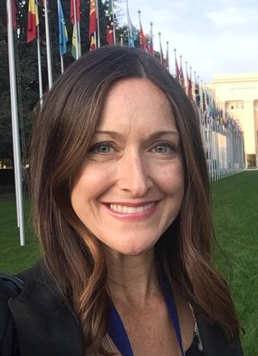
Kristi Disney Bruckner, JD, LLM
Professor Bruckner is Executive Director of Sustainable Development Strategies Group (SDSG). Her work is focused on mining, community rights, and sustainable development, including 16 Extractive Industries Transparency Initiative validation reports and guidance for the Intergovernmental Forum on Mining, Minerals, Metals, and Sustainable Development.

Slide 10

Ashley Smith-Roberts, JD, LLM
Professor Smith-Roberts is a Consultant at SDSG, where she focuses on issues of international environmental law and human rights in the mining sector. She has collaborated with lawyers across the globe to evaluate trends in global supply chains and has authored white papers on sustainable development.

Slide 11
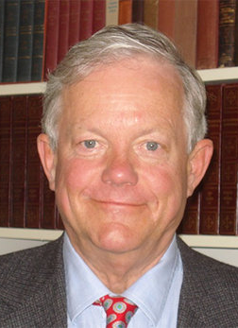
Luke J. Danielson, JD
Professor Danielson is the President and Co-Founder of SDSG. He was the Executive Director of the path-breaking global Mining Minerals and Sustainable Development Project. He is an attorney, professor, researcher, and consultant on minerals policy and sustainable development.

Slide 12
Learning Objectives:
Students will gain…
Understanding of the concept of sustainable development through key international frameworks.
Knowledge of key frameworks related to community engagement, community rights, and Indigenous rights.
Ability to identify “hot topics” in the field, such as advancing gender equality, climate mitigation and adaptation, and technological advancement.
Exposure to experts in the field.
Opportunities to practice and improve oral and written communications.

Slide 13
Learning Outcomes:
Students will be able to…
Understand and apply the principles of sustainable development.
Identify common impacts and benefits of the mining sector on communities near mineral development.
Describe key frameworks and mechanisms utilized to boost engagement with communities and optimize contributions of mining to sustainable development
Describe the concept of Free Prior Informed Consent
Understand obstacles and opportunities for implementation of relevant legal frameworks, from the perspectives of a wide range of stakeholders.

Slide 14
Course Modules
The Concept of Sustainable Development of Natural Resources
Understanding and Respecting the Rights and Roles of Communities in the Mining Sector
Defining the “Community:” Methods
Special Rights of Indigenous Peoples
Common Sources of Community Conflict
Community Engagement and Consultation
Understanding Community Impacts of the Mining Sector
Strategic Environmental Assessments, Land Rights, and Resettlement
Artisanal and Small-Scale Mining
Sharing Benefits with Communities
Preparing for Mine Closure and Post-Mining Transition
Cross-Cutting Topics: Advancing Gender Equality, Climate Mitigation and Adaptation, Technological Advancements and Shared Value

Slide 15
Guest Lectures Include:
Nadia Ahmad, Associate Professor of Law, Barry University
Laura Barreto, Director, Materials Efficiency Research Group, Board of Directors and Former Chair, Alliance for Responsible Mining
Flaviano Bianchini, Founder and Director, Source International
Aimee Boulanger, Executive Director, Initiative for Responsible Mining Assurance (IRMA)
Joan Carling, Co-Convener, Indigenous Peoples Major Group for Sustainable Development
Sebastián Donoso, Sebastián Donoso & Asociados
Dr. Ana Maria Esteves, Managing Director, and Vera Ogorodnikova, Senior Consultant, Community Insights Group
Dr. Ginger Gibson, Director, The Firelight Group
Trevor Jones, Lynx Global Intelligence
Jordon Kuschminder, Civility Studio
Travis Lowder, National Renewable Energy Laboratory
Daniele La Porta, World Bank Climate-Smart Mining

Slide 16
Guest Lectures, cont:
Ved Nanda, Director, Ved Nanda Center for International and Comparative Law, University of Denver Sturm College of Law
Clémence Naré, Outreach Manager and Law Advisor, Isabelle Ramdoo, Deputy Director, and Ege Tekinbas, Gender Equality Advisor, Intergovernmental Forum on Mining, Minerals, Metals and Sustainable Development
Flavia Noejovich, Independent Consultant
Batbold Otgonbayar, Co-founder and Chair, Mongolian Council for Sustainable Development and Social Responsibility
James Otto, Independent Consultant
Brendan Schwartz, Senior Researcher, Natural Resources, International Institute for Environment and Development
Sheldon Spotted Elk, Program Director, Tribal Justice Partnerships, National Council of Juvenile and Family Court Judges
Luke Stephens, Principal Social Specialist, RPMGlobal
Perrine Toledano, Columbia Center on Sustainable Investment
Vasco van Roosmalen, Director, Amazon Conservation Team (ECAM)

Slide 17
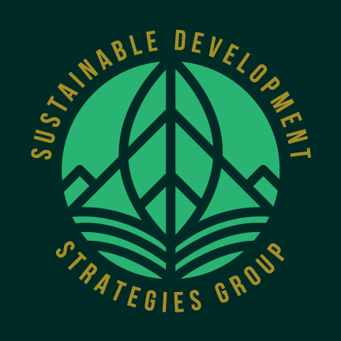
This course was developed by SDSG, an independent, nonprofit research institute developed in 2007 to advance the best practices for sustainable management of renewable energy and natural resources. www.SDSG.org

Slide 18
Contacts:
Kristi Disney Bruckner, disney@sdsg.org
Ashley Smith-Roberts, smith-roberts@sdsg.org
Luke J. Danielson, danielson@sdsg.org
www.SDSG.org

