Slide 1
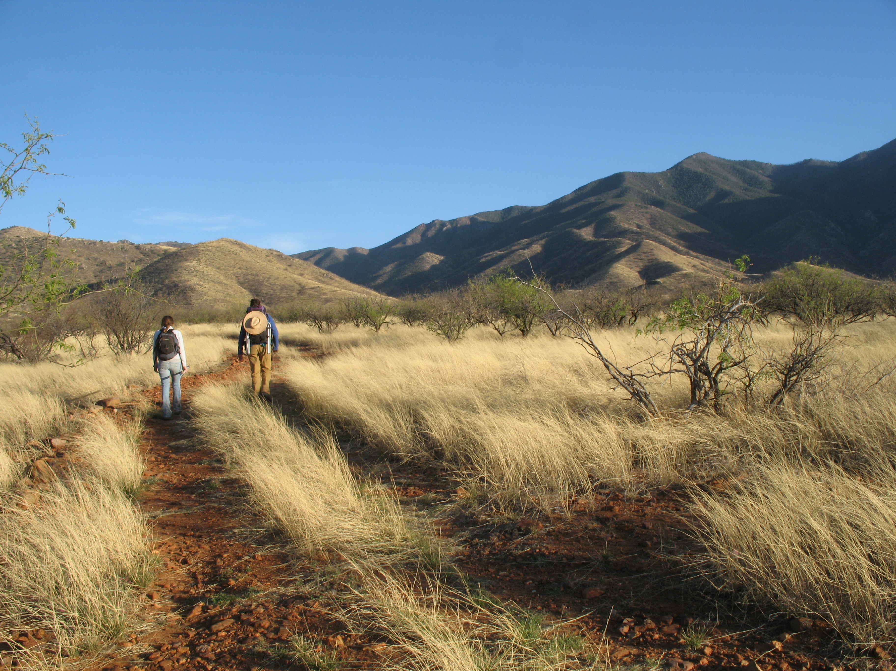


NRULPC Advisory Board Meeting
December 7, 2023 | 9:15 am-12:00 pm

Slide 2


Welcome
- Ethan Orr and John Lacy, Co-Directors

Slide 3
Review Agenda
- John Lacy
Agenda
Opening Remarks – Ed Martin
Advisory Board Members Introductions
NRULPC Highlights
Natural Resource Use & Management Clinic Highlights
Update on Projects Coordination
Role, Structure and Rotation of AB
Budget and Administrative Update
Guest Speaker – Sharma Torrens
Mining Law Summit
Final Comments, Thank You and Adjourn
Next Meeting – Spring 2024

Slide 4
Opening Remarks
- Ed Martin, Associate Vice President and
Director of the Arizona Cooperative Extension System

Slide 5
Advisory Board Members Introductions
- Ethan Orr
Please give a BRIEF introduction of yourself.

Slide 6
NRULPC Highlights
- Ethan Orr and John Lacy
Collaboration(s):
  School of Mining and Mineral Resources (newly formed)
  College of Law’s Global Mining Law Center
  Cooperative Extension
Center (5 yr.) Review & Reauthorization
Prescott National Forest MOU
Alternatives for irrigation districts with CAP water allocation reductions
Notes:
Center (5 yr.) Review & Reauthorization
University-level process designed to provide a clear assessment of the strengths and challenges and guide the future direction of activities
in conjunction with UA RII (Office of Research, Impact & Innovation)
Prescott National Forest MOU
George (Ruyle) was instrumental in developing the MOU,
MOU calls for "develop[ment of] cooperative monitoring programs, allotment-specific monitoring plans and conduct [of] on-the-ground monitoring, inventories and assessments” with respect to the nearly four dozen grazing allotments in the PNF

Slide 7
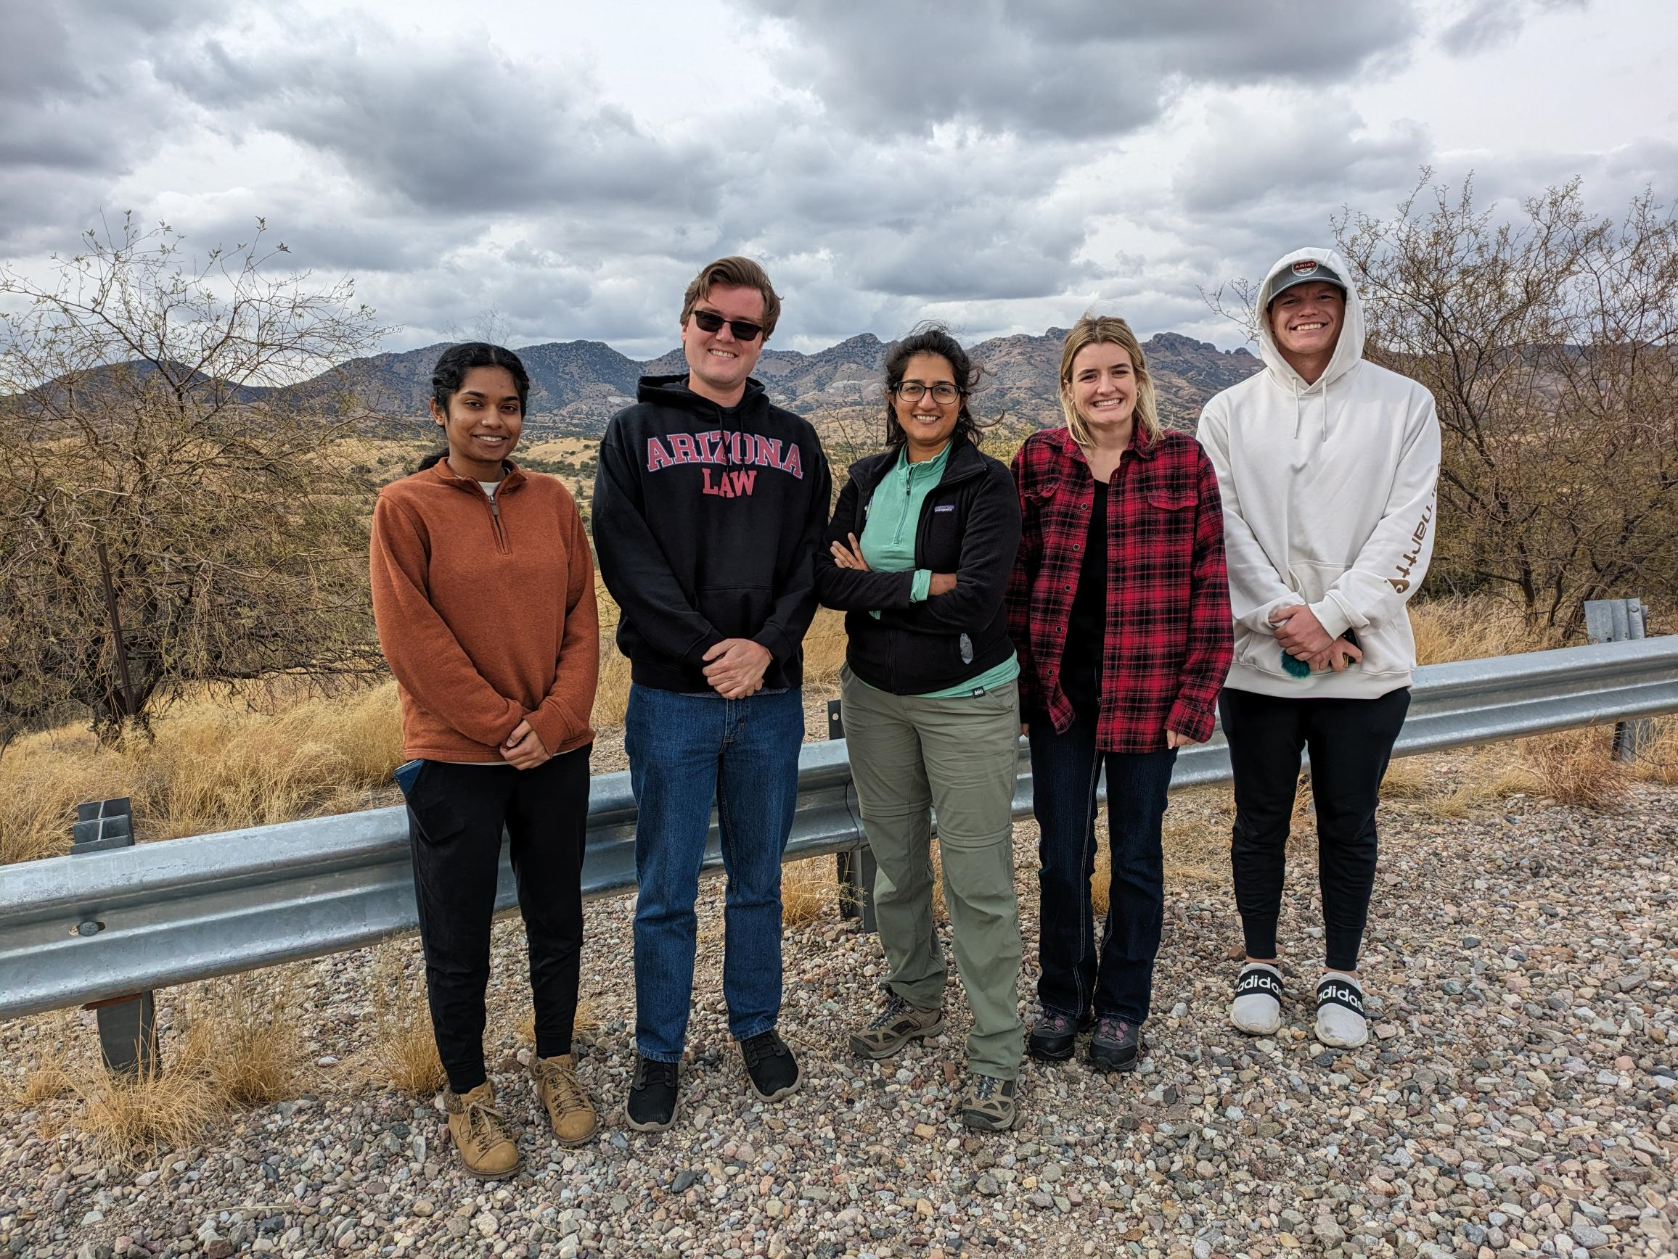
Natural Resource Use & Management Clinic
- Priya Sundareshan, Outgoing Director
Fall 2023
  5 JD students
  2 projects
    Town of Patagonia
    AZ Youth Climate Coalition
  Co-taught SCI/LAW undergrad course

Slide 8
Natural Resource Use & Management Clinic
- John Barrett, Incoming Director
Introduction
  Vermont Law School 2002
  Judicial clerkship (3 years); private practice (8 ½ years); non-profits (7 ½ years)
  Fennemore; Arizona Land & Water Trust
Clinic Spring 2024
  6 total students; 3 returning from fall 2023
  Program Focus: Transactions, Collaboration, Negotiation, Advice
Since October 23, 2023
  Connecting with attorneys to build network of subject-matter experts
  Promote clinic to non-profits and connected individuals who can amplify public awareness
  Support and advise on Adjudication Project
  Create a relevant syllabus and arrange for guest speakers
Water Adjudication project

Slide 9
AZ Extension Ecosystem: A two-way system for enhancing economic and social wellbeing – where does legal capacity fit?
- Colin McKenzie, Fellow

Slide 10
Break
Back at 11:05 am

Slide 11
Role, Structure and Rotation of Advisory Board
- Ethan Orr

Slide 12
Budget and Administrative Update
- Ethan Orr

Slide 13
Featured Speaker
Conserving Ranches
Sharma Torrens

Slide 14
Mining Law Summits
John Lacy

Slide 15
Final Comments and Adjourn
THANK YOU
FOR YOUR COMMITMENT TO THE NRULPC and CLINIC!
Next Meeting – Spring 2024

