Slide 1
NRULPC Advisory Board Meeting
May 26, 2023 | 10:00 am-2:00 pm

Slide 2
Welcome - George Ruyle and John Lacy, Co-Directors

Slide 3
Review Agenda - John Lacy
Agenda
NRULPC Highlights
Update on Natural Resource Use & Management Clinic
Undergraduate Class
American Indian and Tribal Perspectives
Featured Speaker – Pilar Thomas
Thank You’s and Adjourn
Lunch and Networking
Special Event – Tai Kreider
Next Meeting – Fall 2023

Slide 4
Advisory Board Members Introductions - George Ruyle
Please give a BRIEF introduction of yourself.

Slide 5
NRULPC Objectives - George Ruyle and John Lacy
Objectives
Train students to critically evaluate complex natural resource law and policy matters in real time with a hands-on approach to learning – learning by doing.
Combine the science-based knowledge of CALS students and the legal skills of law students to promote responsible stewardship of natural resources.
Build relationships among collaborative partners and the larger community.
Increase the law, policy, and economic analysis capacity of Cooperative Extension.
Support a public interest law clinic on matters involving the regulation and use of natural resources.
Provide an undergraduate level core-knowledge survey course highlighting presentations from legal experts serving the agricultural and natural resource industries.

Slide 6
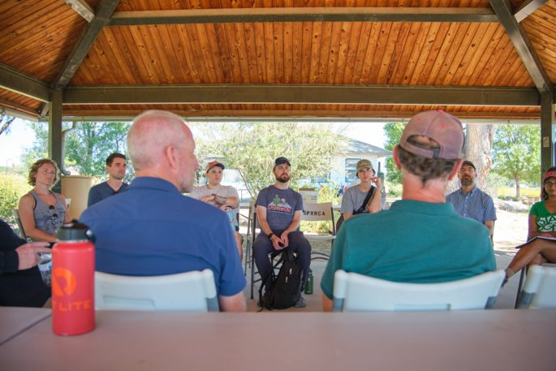
Natural Resource Use & Management Clinic - Priya Sundareshan, Director
Spring 2023
Director on partial leave
3 returning JD students
3 projects
Farming community
Calif. groundwater regulations
Federal reserved water rights
Fall 2023 – 8 JD students
Co-teaching Sci/Law course
Water Adjudications project

Slide 7
Agriculture Environmental Legal Issues Course Update ACBS/RNR/LAW 411 Joint Course Spring 2023 Course instructors: Joe Willis, Esq. and Anne Gondor
•Overall purpose is to present a balanced view from the resource users' perspective and promote law as a career option to students working on degrees associated with agriculture, veterinary sciences and natural resource use
Increased enrollment to 30 students (28 successfully completed)
8 College of Law students (only 2 registered under LAW)
18 College of Ag students – Veterinary/Animal Sciences (10), Agribusiness (1), Nutrition and Food Systems (7)
1 Eller College of Mgmt, 1 Chemistry
Proposed to be added as curriculum in new undergrad major BA in Geosciences and Society

Slide 8
•17 Industry expert guest speakers presented on 14 topics:
Arizona Water Law Types of water regulated
*History of AZ water law
WOTUS
CERCLA
Endangered Species Act (ESA)
Food Safety (FSMA)
NEPA
Conservation Easements ​
Contracts and Real Property​
*Local Government Engagement ​
Outbreak Investigation ​
*Ranching ​
*Tribal Law​
*Farm Bill 2023
*Many thanks to the 5 NRULPC Board Members who presented this year!

Slide 9
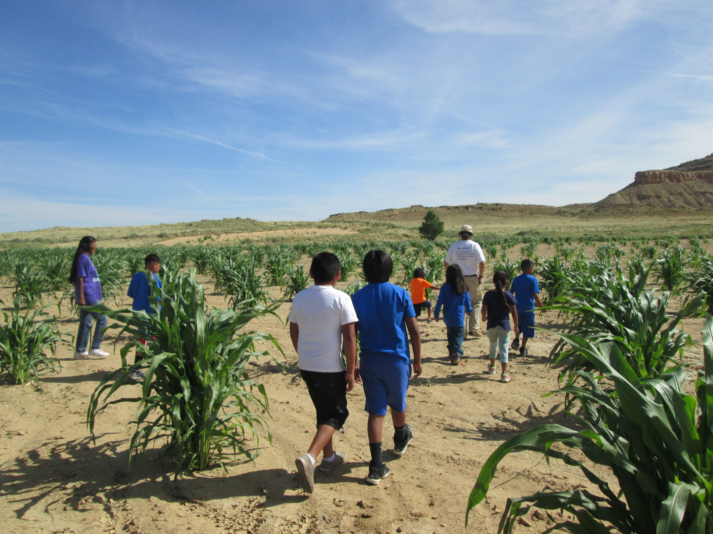
American Indian and Tribal Perspective - Michael Kotutwa Johnson, Affiliated Faculty
Example Topic Areas
Regenerative Agriculture
Renewable Energy
Fish and Wildlife
Forestry
Biodiversity
Traditional Ecological Knowledge

Slide 10
Featured Speaker
Co-Management of Federal Lands with
Tribal Participation
Pilar Thomas – Part-time Professor of Practice

Slide 11
Adjourn
THANK YOU
FOR YOUR COMMITMENT TO THE NRULPC and CLINIC!
Next Meeting – Fall 2023

Slide 12
Lunch and Networking

Slide 13
Special Event
Cowboys, Horse Soldiers, and College Kids –
Playing Real Polo in the American West
Tai Kreidler – Texas Tech University

