Slide 1
NRULPC Advisory Board Meeting
April 27, 2021 8:30 am-12:00 pm

Slide 2
Welcome/Check-in, Review Agenda - Joe Willis, Advisory Board Co-chair & Andy Groseta, Advisory Board Co-Chair
Agenda
Highlights of NRULPC Progress
Keynote Speaker - Carla Consoli
Update on Undergraduate Course
Clinic Program Review
Lightning Round
Updates/Introductions
Financial Report & Fundraising Campaign
Communications Update
Thank You’s and Adjourn
Next Meeting – first of December "in person"

Slide 3
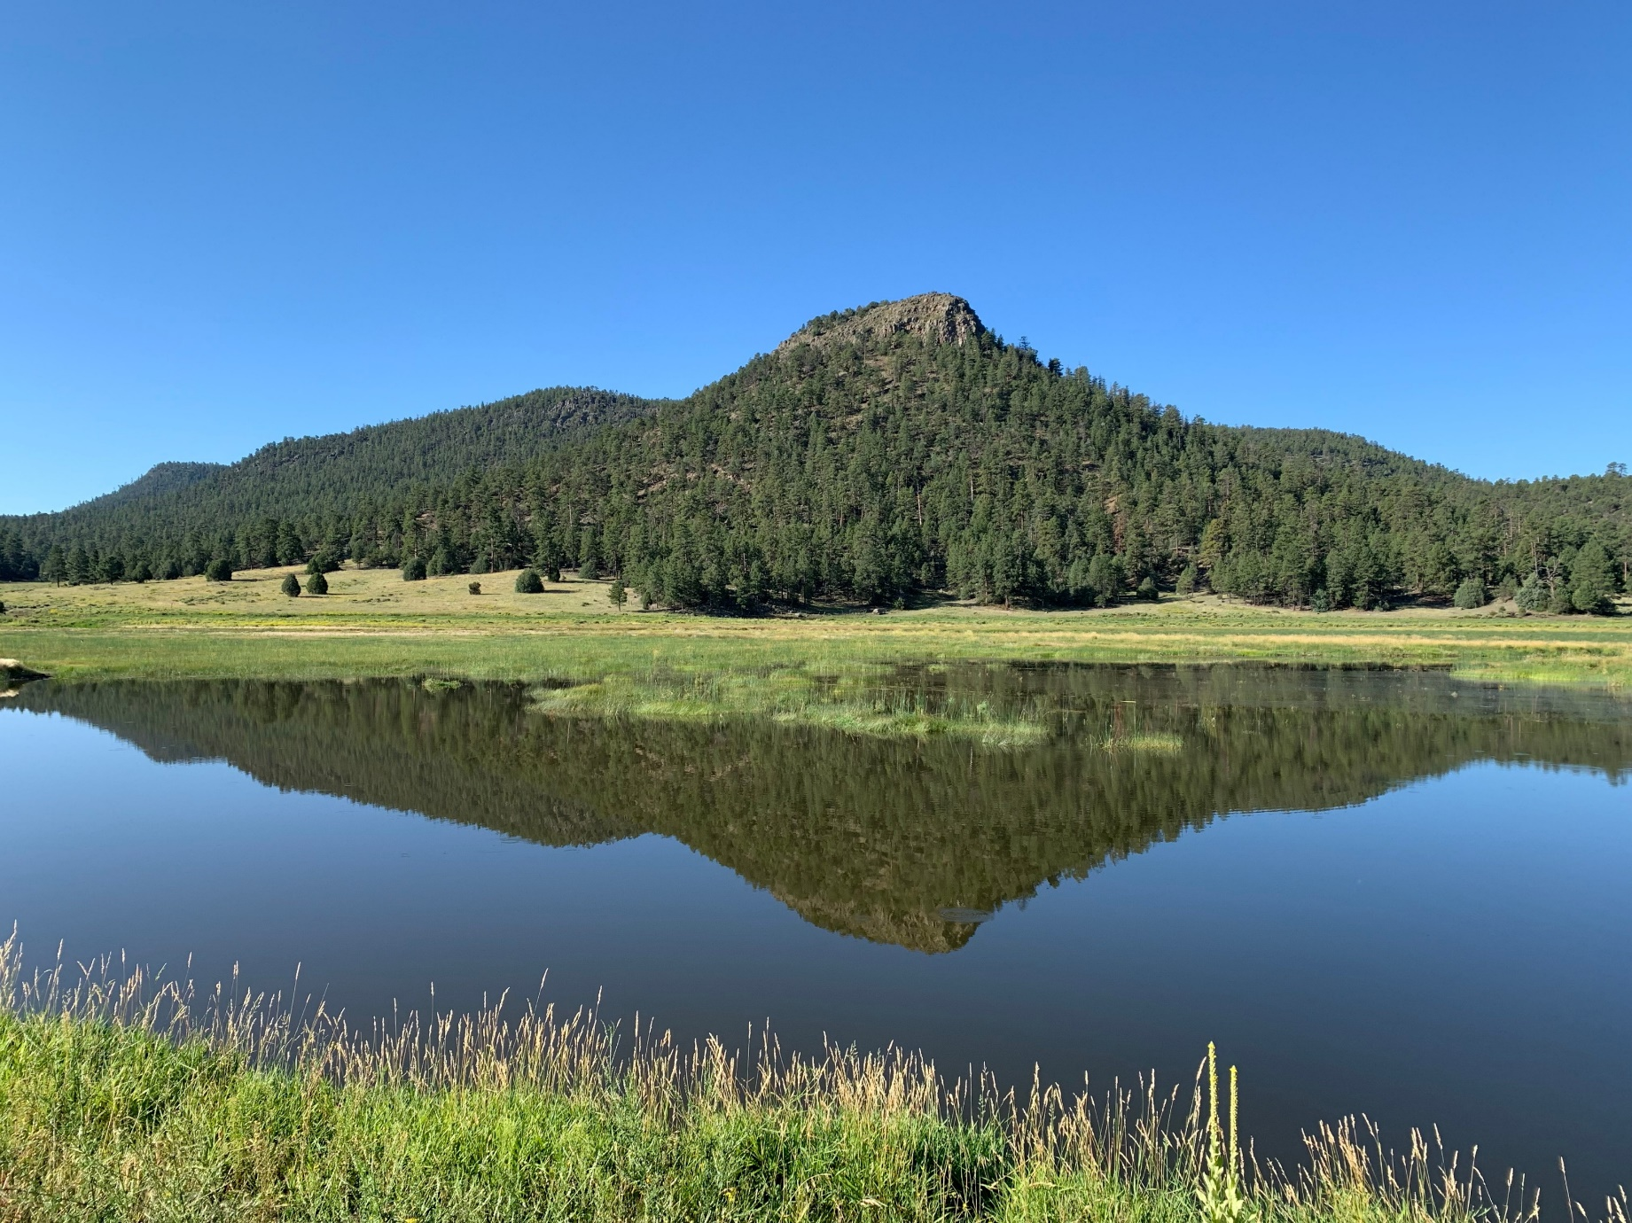
NRULPC Progress Highlights - George Ruyle & John Lacy, Co-Directors
The Center's overall mission is to help landowners, farmers & ranchers in Arizona navigate the legal and regulatory hurdles to using the land

Slide 4
Benefiting the Natural Resource Community by:
Exposing students to complex natural resource law and policy matters through the NRUM Clinic – Examples of “learning by doing”
Increasing the law and policy analysis capacity of Cooperative Extension to serve natural resource users
Building partnerships amongst natural resource users and the larger community
Offering a public interest Natural Resources Use and Management Clinic to serve stakeholders and engage students
Helping stakeholders in Arizona and the West solve their legal hurdles

Slide 5
Recent Center Projects - George Ruyle & Jeff Eisenberg
Consultation regarding drought-influenced stocking rates
Submitted comments on proposed FS rangeland management directives
Added “Litigation and Agency Decision Resources” page to website
Memo on environmental litigation seeking to overturn USFS use of categorical exclusions
Completed analysis of NEPA issues in ongoing litigation over San Pedro Riparian National Conservation Area Resource Management Plan (SPRNCA)
Assisted permittees with questions on AOI procedures
Background research on pathology paper
Continued conversations regarding water supply for Clifton

Slide 6
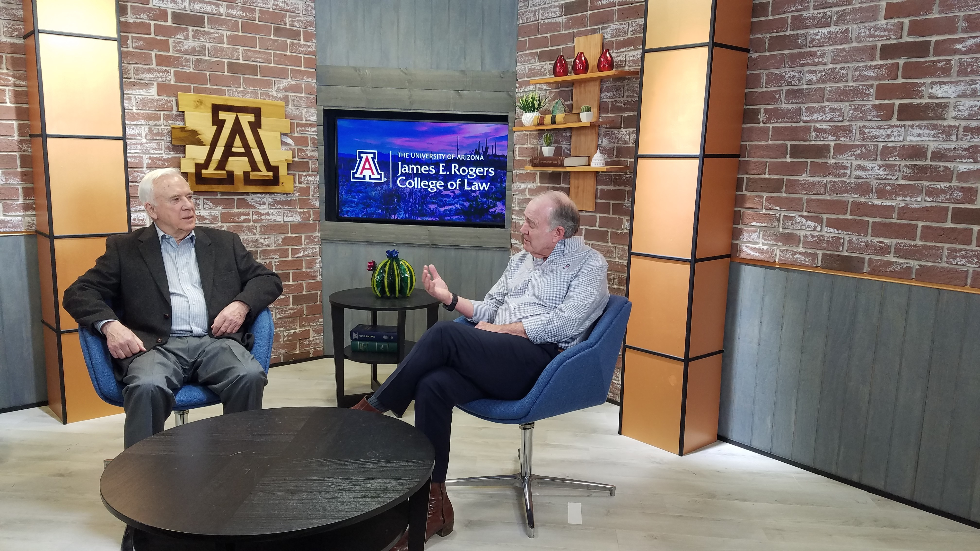
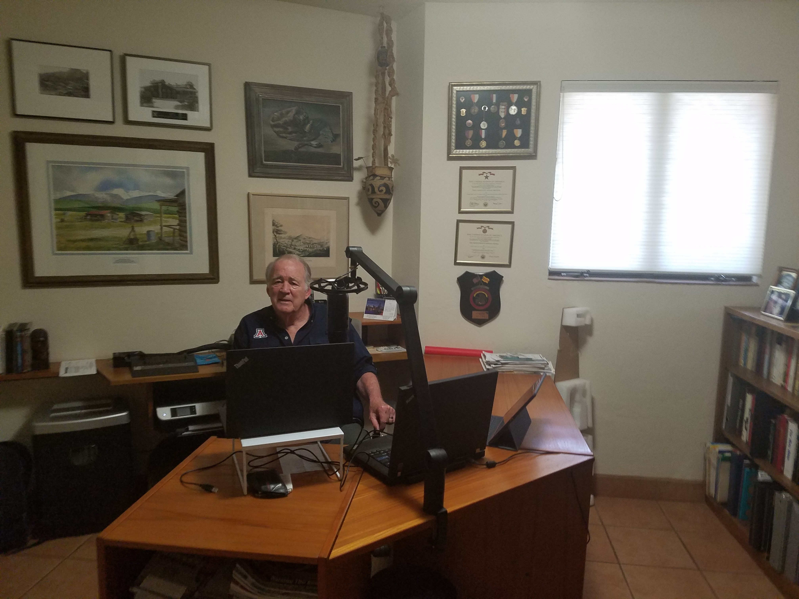
Online Training Programs
Course on Developing Public Lands Under the National Environmental Policy Act
Course on Public Land Use
Available to students in the Clinic, students in CALS and as executive training
Video postings of lectures and interviews on current topics
Colorado River conservation
Waters of the United States
Undergraduate Courses on Natural Resources Issues

Slide 7
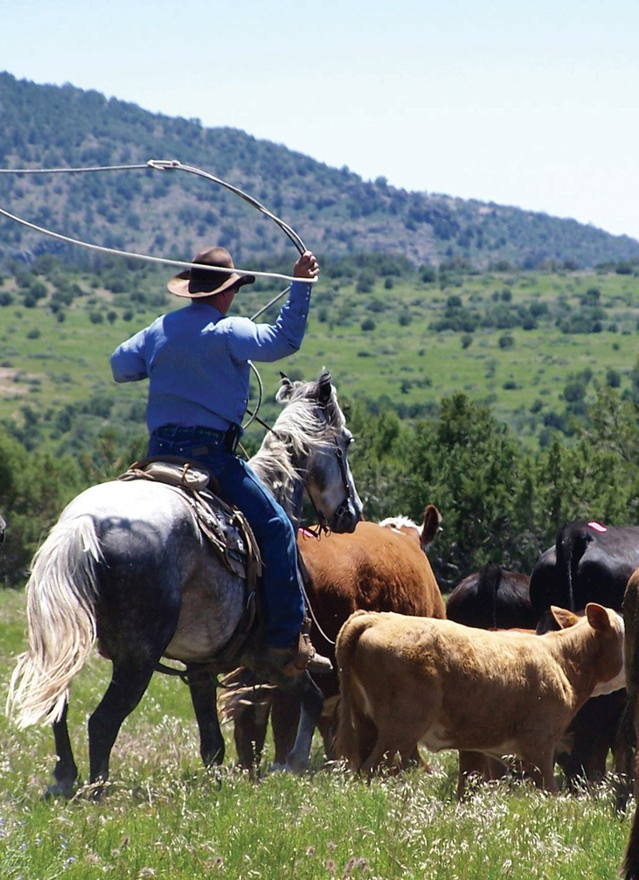
Keynote Speaker
The comparison of the political environment in the permitting process from the Obama, Trump and Biden administrations
Carla Consoli, Partner and Regulatory and Government Practice Group Leader

Slide 8
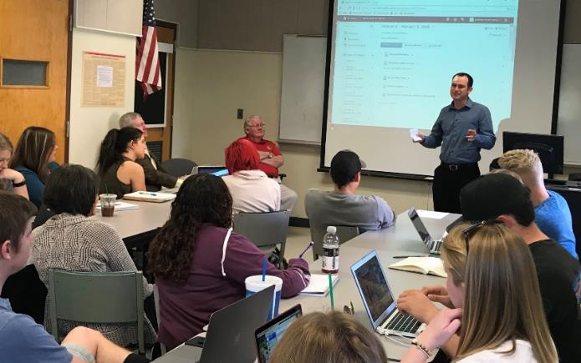
Agriculture, Environmental and Legal Issues Course Update ACBS/Law 411 Joint Course Spring 2021 - Course instructors: Joe Willis, Esq. and Anne Gondor
Overall purpose to present a balanced view from the resource users' perspective and promote law as a career option to students working on degrees associated with natural resource use
Need to create beginning and end student survey to gauge
2021 - ACBS 12 students, LAW 12 students (12 seniors, 9 juniors, 3 sophomores)
Live Zoom (synchronous) online for Spring 2021
17 guest speakers scheduled
Materials, quizzes, exams delivered by D2L
How do we encourage more SNRE students?
Photo: Spring 2019
Notes:
The ACBS-LAW 411 Joint Course is titled An Introduction to Agricultural Law and Policy for the Modern-Day Natural Resource User. The overall purpose of the class is to present a balanced view from the resource users’ perspective as well as to promote law as a career option to students working on degrees associated with natural resource use. My observation is that we also need to create a start and end survey to gauge whether or not we are reaching that goal to understand the student's motivation for taking the class and if their trajectory changes towards law after the class. In 2020 we had 18 students from ACBS and 7 students from LAW, How do we NOW encourage more students joining the course from SNRE programs? the School of Natural Resources and the Environment?
This spring semester the course will be entirely online, with synchronous Live Zoom lectures and plans for having 16 guest speakers. Content materials, quizzes, exams and assignments will all be delivered using D2L

Slide 9
Guest Speaker Highlights – New Topics
Tribal Law Basics - guest speaker, Sarah Roubidoux Lawson,
Of Counsel with Schwabe, Williamson and Wyatt
Sarah’s Law specialty is Industry focused; Covid-19 resources, Natural Resources, Real Estate & Construction, she has represented in the past the Tohono O’ohdam Nation
Class presentation: April 20, 2021, 11am – 12:15 pm
News from Washington – guest speaker, Jeff Eisenberg
Consultant to NRULPC
Class presentation: April 29, 2021, 11am – 12:15 pm
Speakers have been asked to add additional information on how COVID 19 has impacted their topic, new regulatory changes, or highlight relevant information that students have suggested due to their interests and majors.
email gondora@email.arizona.edu if interested to join the Zoom presentations
Notes:
We have planned some enhancements to the course based on our experiences last spring. One is to add a NEW topic, the Basics of Tribal Law with guest speaker Sara Roubidoux Lawson who is Of Counsel with Schwabe, Williamson and Wyatt. She specializes in Industry focused law,, Natural resources, Real Estate and Construction Law as well as Covid-19 resources law, she has in the past represented the Tohono O’Oodham Nation.
We have also planned ways to improve student engagement by using The D2L Discussion Tool, which is a way for students to discuss a topic via chat or by using the Voice Thread tool, which provides a more dynamic way for students to submit discussion assignments by using video, PowerPoint or chat.
Last spring we were surprised at how few students followed current events, so we added current event articles into content and extra credit assignments, these will be updated
To increase our instructor presence so students see us as real people, we will add recorded video to our D2L Announcements for weekly sessions
Now that we have Panopto recordings of 14 - Zoom lectures from last Spring, we can also use the practice quiz feature to use them as study guides or use them as the lecture if we lose a live guest lecturer in the schedule.
We plan to revive the student group presentation assignment. This will require using Zoom Break-out rooms to allow students initial coordination, then, to submit the presentation, they will use the Voice Thread Tool in D2L allowing other students to view each presentation and submit their comments or questions to receive their grades.
To prevent students “gaming the system” (last year we observed a few students signing into chat and leaving after 15 minutes) we will Adjust the Points awarded for the Participation Attendance of live sessions by requiring students to type in Zoom chat their perceived “muddiest point in the lecture, and their clearest point in the lecture” at intervals during the live session. This has added value by providing us built in feedback on how to improve our future lectures. If students have an excused absence and miss a live session, they can catch up by viewing the recording of the session.

Slide 10
Implemented student engagement improvements:
Current event articles added to extra credit assignments and course content
Revived student group presentations (class last day lightening round)
Added “Practice Quiz” feature on some Panopto Zoom recordings
D2L Quiz feature that allows to retake just the questions answered incorrectly
Photo: Zoom Speaker John Barrett Spring 2020
Notes:
Some potential issues we experienced last year that we will be watching for are:
To make sure students have adequate internet connectivity,
Attendance to Synchronous live lectures may prove difficult for remote international students (so for that case, we will make a provision in D2L for asynchronous recordings).
Students academic performance may be impacted by the pandemic, so increasing our online presence can have a positive impact on that, we will monitor for this through participation and student engagement assignments. Some remedies we used last spring were to give additional attention via email to students struggling. We will also continue to take advantage of on campus support webinar systems like the office of Instruction and Assessment (OIA) to learn new techniques and hear how other instructors solve these issues. There is also a new D2L Quiz feature that we can implement that allows students to retake only the quiz questions they answered incorrectly.

Slide 11
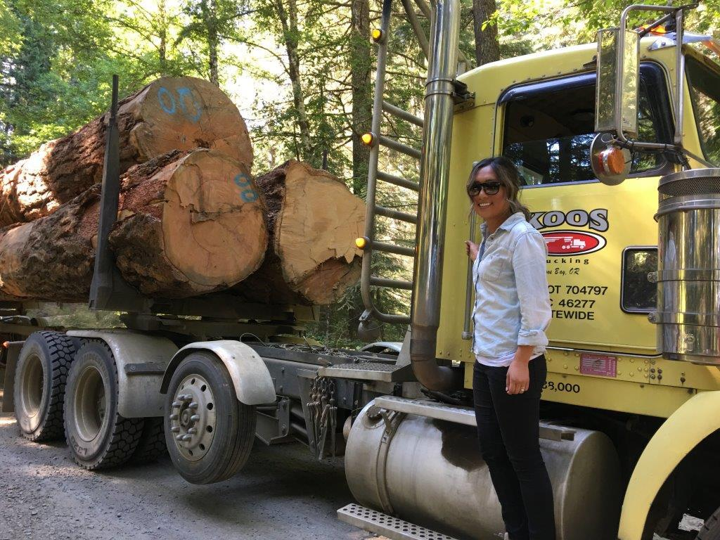
Clinic Program Review - Priya Sundareshan, Clinic Director
4 JD students currently enrolled in Spring 2021
7 JD students in Fall 2019; 3 JD and 1 MLS in Spring 2020; 5 JD and 1 MLS in Fall 2020
1 JD student did a hybrid externship/clinic enrollment over Summer 2019 and Summer 2020 with Idaho Forest Group
*Student internships a great way to get students into field; if you have ideas for possible internships, can work with Clinic and Center to circulate to students and facilitate.

Slide 12
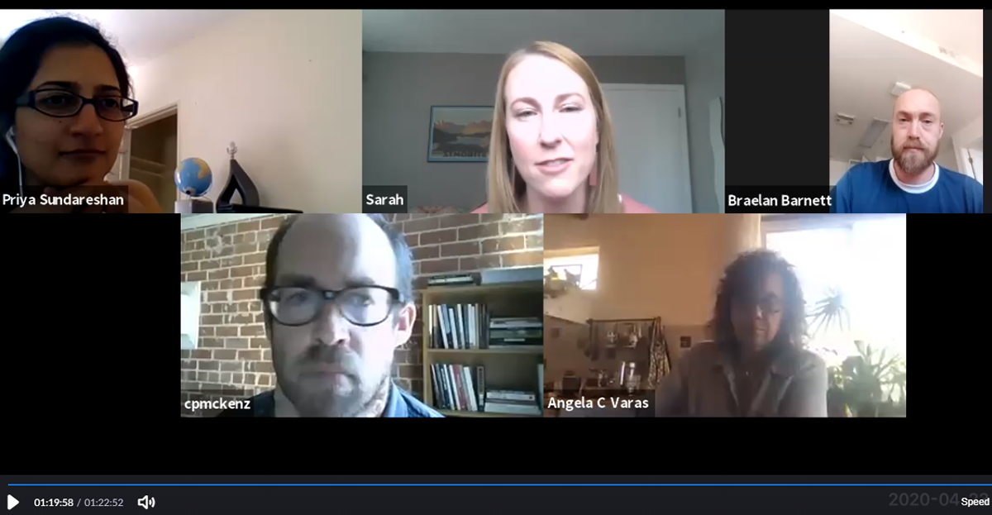
Clinic Structure
Weekly seminars: students meet in classroom, lessons on substantive law, project rounds, student presentations, guest lecturers, exercises
Individual projects: students work alone or in groups on projects for the NRULPC, Cooperative Extension, tribes, and other client organizations.
Weekly individual meetings with Director or Fellow, in addition to meetings with NRULPC, clients, and University experts.
Class and project meetings are being held via Zoom

Slide 13
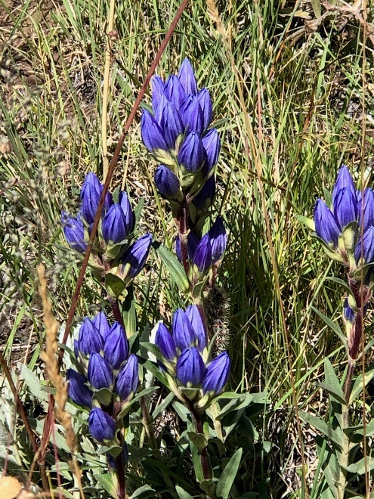
Current Clinic Projects
Notice and comment process and engagement
Follow-up on prior comments to Oak Flat / Resolution Mine EIS
Planning curriculum and tribal consultation about student participation in the state water rights adjudication
Use of artificial beaver dams as mitigation banks under CWA
Engaging with Colorado River allocation scarcity and assisting with proposals for water conservation in farming
Facilitating community solar developments in Arizona
Advocacy workshop: stakeholder perspectives and influence

Slide 14
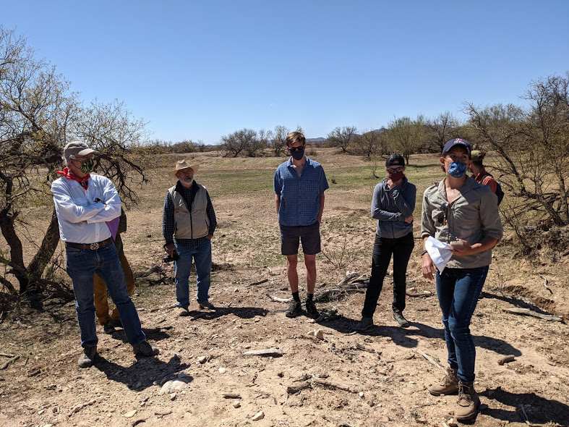
Outside the Classroom – Altar Valley Conservation Alliance Science Field Trip

Slide 15
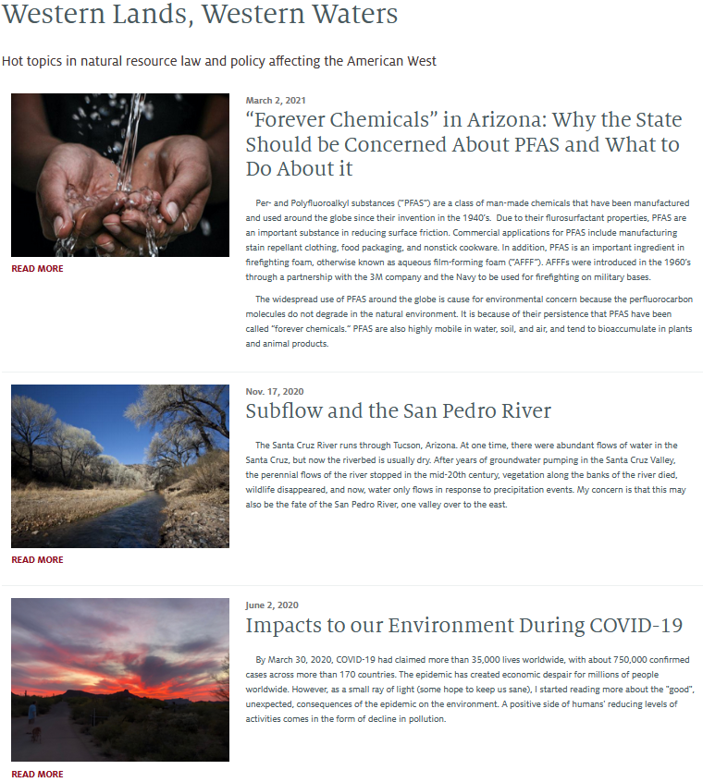
Western Lands Blog
https://westernlandsblog.arizona.edu/

Slide 16
Lightning Round - Law Clinic Student 5-minute presentations
Luke Erickson –
Update on Student Participation in Gila River Adjudication
Will Fortna & Luke Erickson –
Developing a Pinal County Watershed Plan
Emily Ellis –
Watershed Site Selection and Using Alternative Beaver Dam Structures as an Innovative Form of Mitigation Banking Under CWA 404
Derek Brewer –
Facilitating Community Solar Projects in Arizona

Slide 17
Q&A

Slide 18
Break
Back at 10:45

Slide 19
Advisory Board Member Introductions & Interests - John
Introduce yourself
Describe in one or two sentences a current natural resource issue you are working on or are concerned about
Poll question:
Select your top two suggestions for keynote speakers at the next AB meeting
Mexican wolf re-introduction
Feral horses
Impacts of current drought on ranching
Community relations in natural resource development
Prescribed burning
Creating products from forest thinning
Invasive species

Slide 20
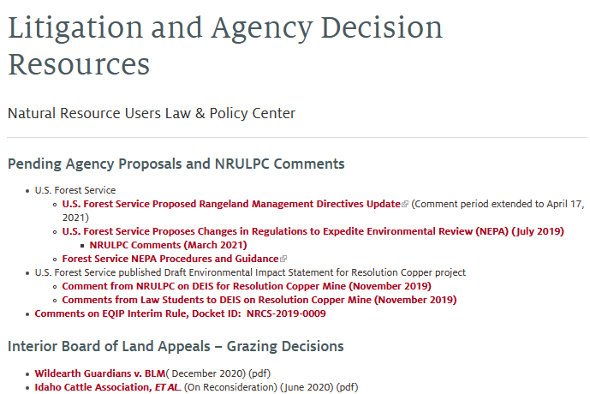
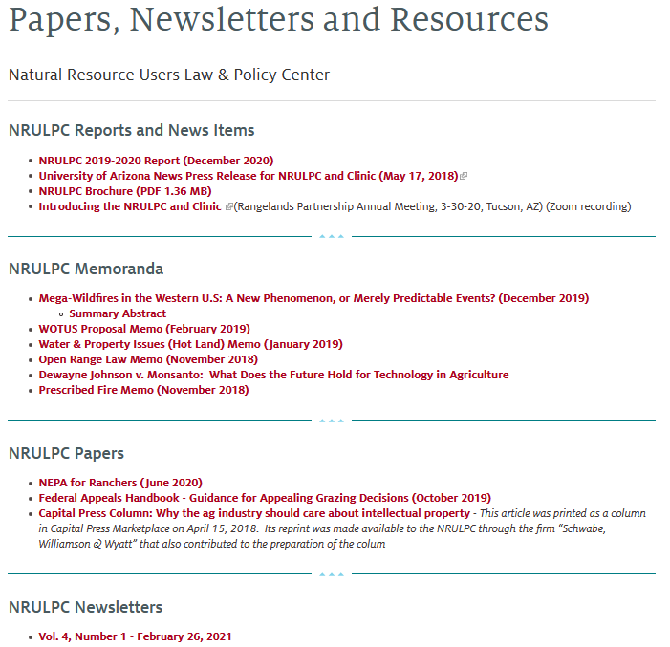
Communications update - Barb Hutchinson and Sheila Merrigan
Current communication outlets
Newsletter
Listserv
Website revisions - https://extension.arizona.edu/nrulpc
Blog
RREA/NIFA webinars - https://globalrangelands.org/rreasp/webinars
Proposed new communication services
(Marley & CES Proposals)
Regulatory Roundup
Fact Sheets
Webinars

Slide 21
Adjourn
THANK YOU
FOR YOUR COMMITMENT TO THE NRULPC and CLINIC!
Next Meeting – first of December "in person"

